Slide 1


Onions in the Cloud Make the CISO Proud
Wes Lambert
@therealwlambert
DEF CON Cloud Village 2021

Slide 2
Agenda
The Cloud
Introduction to Security Onion
Security Onion in the Cloud

Slide 3
The Cloud - Data Storage/Transit
Amazon Web Services
S3 Buckets
Dynamo DB
Azure
Blobs
Event Hubs
Google Cloud Platform
Storage Buckets
Cloud Datastore/Filestore
Application/Network Traffic

Slide 4
The Cloud - Data Exploited/Abused
AWS (Amazon Web Services)
S3Scanner
scan for open S3 buckets
Pacu
AWS exploitation framework
https://github.com/sa7mon/S3Scanner
https://github.com/RhinoSecurityLabs/pacu

Slide 5
The Cloud - Data Exploited/Abused
Azure
MicroBurst
Azure Services discovery
weak configuration auditing
post exploitation actions
https://github.com/NetSPI/MicroBurst

Slide 6
The Cloud - Data Exploited/Abused
GCP (Google Cloud Platform)
GCP-IAM-Privilege-Escalation
Permissions enumeration
Exploits for privilege escalation
GCPBucketBrute
Enumerate Google storage buckets, determine access
Determine if privesc’able
https://github.com/RhinoSecurityLabs/GCP-IAM-Privilege-Escalation

Slide 7
The Cloud - Credentials (AWS)
Account passwords phished via email
IAM account credentials
Root account credentials
Access keys
Control AWS servers without user/pass
Obtained via phish or some other method

Slide 8
The Cloud - Credentials (AWS)
Privilege Escalation
Creating new policy versions
Creating new user access keys
Adding malicious Lambda layer to existing function
https://github.com/RhinoSecurityLabs/AWS-IAM-Privilege-Escalation

Slide 9
Monitoring Challenges

Slide 10
Challenges with NSM in the Cloud
VXLAN encapsulation (AWS)
We can record it, but can our applications handle it?
Segmentation
Ephemerality
Services in the cloud frequently spin up/down
In some cases, no native (scalable) mechanism for network monitoring (Azure)

Slide 11
Security Onion - Introduction
Created by Doug Burks in 2008
Free and open platform for intrusion detection, enterprise security monitoring, and log management
Can be installed from a Centos 7-based ISO image, or packages on top of Ubuntu 18.04, or Centos 7

Slide 12
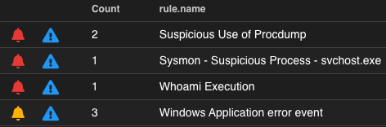
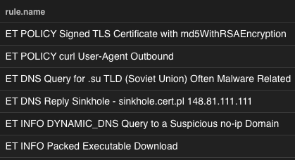
Security Onion: Alert Data
Wazuh - HIDS
Suricata - NIDS
Playbook – Sigma
Strelka - YARA

Slide 13
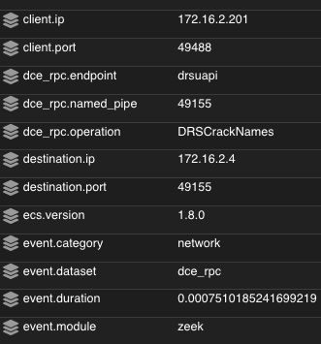
Security Onion: Metadata
Network Metadata
Suricata/Zeek
DNS
HTTP
SMB
TLS
and much more

Slide 14
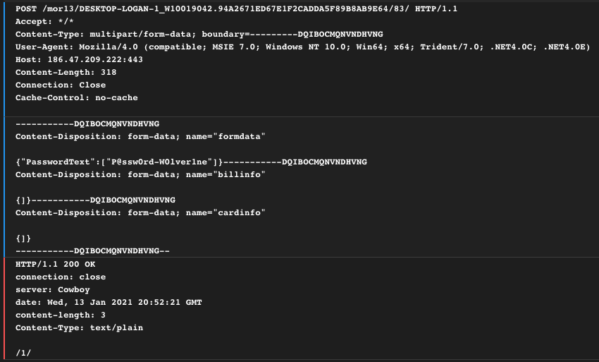
Security Onion: Full Content Data
Full Content Data (PCAP)
Google Stenographer
Complete transcript
PCAP interface in SOC

Slide 15
Security Onion: Supplementary Data
Filebeat Modules
https://docs.securityonion.net/en/latest/filebeat.html#modules
Host Data
(native, as well as shipping Sysmon/Windows Event Logs)
Osquery
Winlogbeat
Wazuh

Slide 16
Traffic Mirroring

Slide 17
Security Onion: AWS Traffic Mirroring

Slide 18
Security Onion: AWS Cloud Node

Slide 19
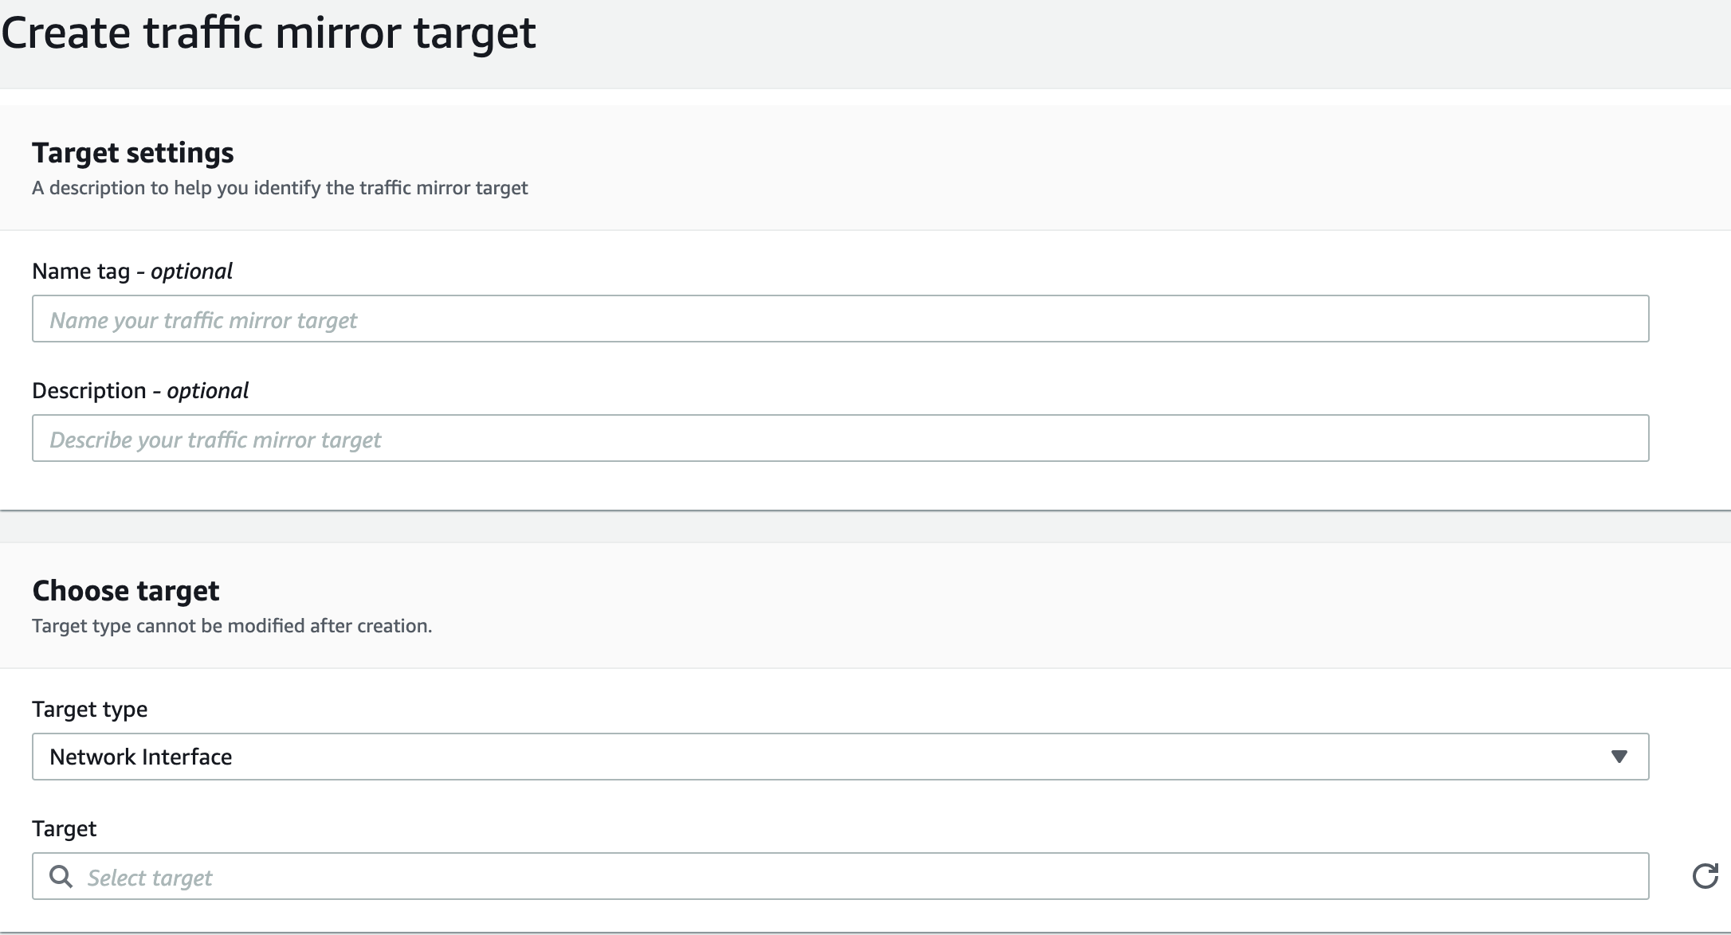
Traffic Mirror Target
Define the target interface where we would like to send mirrored traffic

Slide 20
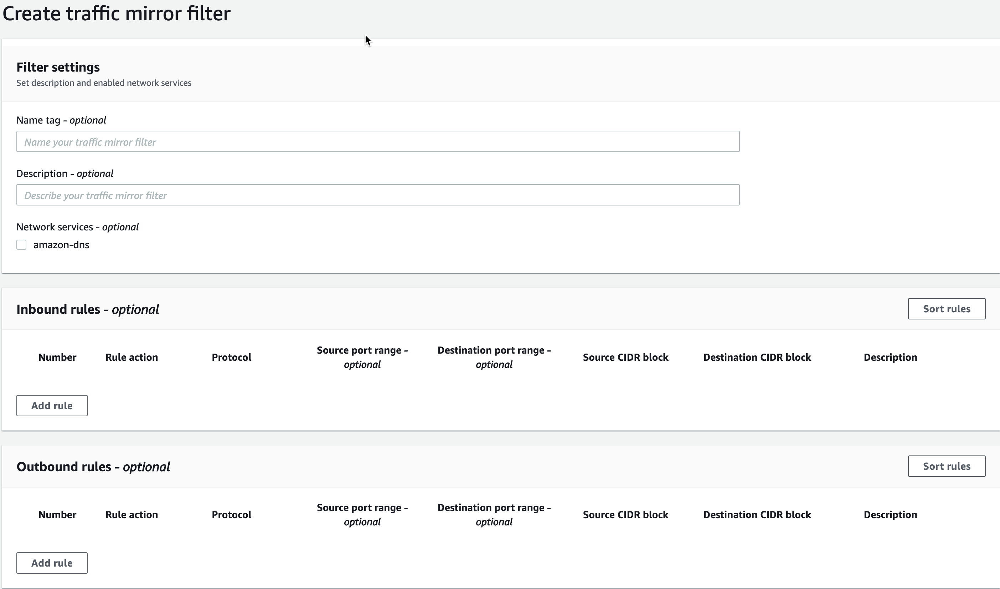
Traffic Mirror Filter
Define the protocols/traffic to be mirrored
Filter out any unwanted traffic

Slide 21
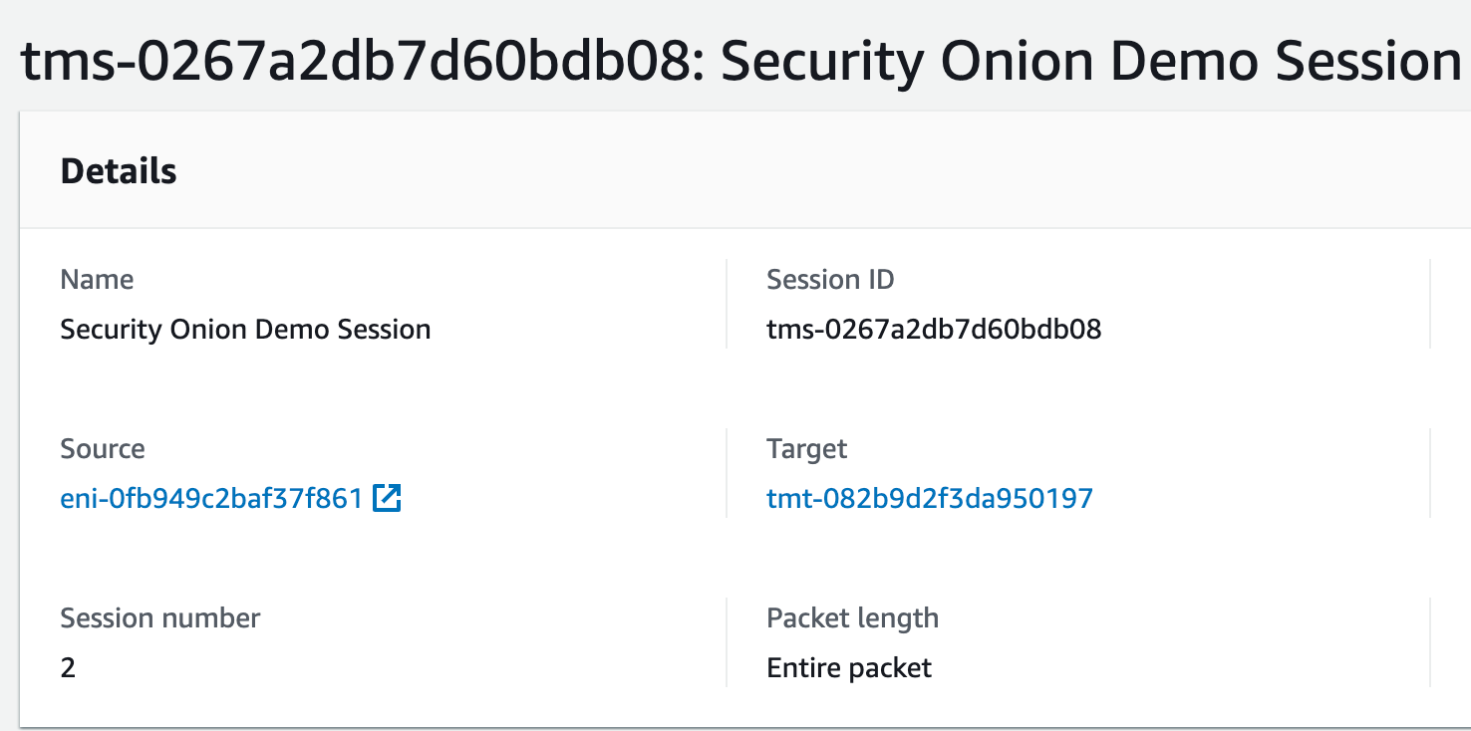
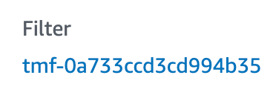
Traffic Mirror Session
Mirror Session is comprised of:
Source interface (to be mirrored)
Target Interface
Mirror Filter

Slide 22
Security Onion: Traffic Mirroring Notes
Suricata (4.1.5+) can natively decapsulate VXLAN
Zeek (3.0.x+) can natively decapsulate VXLAN
Traffic Mirroring is capable with only Nitro-based instances
https://docs.aws.amazon.com/vpc/latest/mirroring/traffic-mirroring-considerations.html
https://docs.aws.amazon.com/AWSEC2/latest/UserGuide/instance-types.html#ec2-nitro-instances

Slide 23
GCP

Slide 24
GCP Packet Mirroring Components
Packet mirroring policy to determine which instances/interfaces participate in traffic mirroring and traffic is mirrored from instance interfaces
TCP/UDP Load Balancer to distribute traffic to a group of instances/interfaces within a collector destination
Collector destination is an instance group where traffic is sent by TCP/UDP load balancer

Slide 25
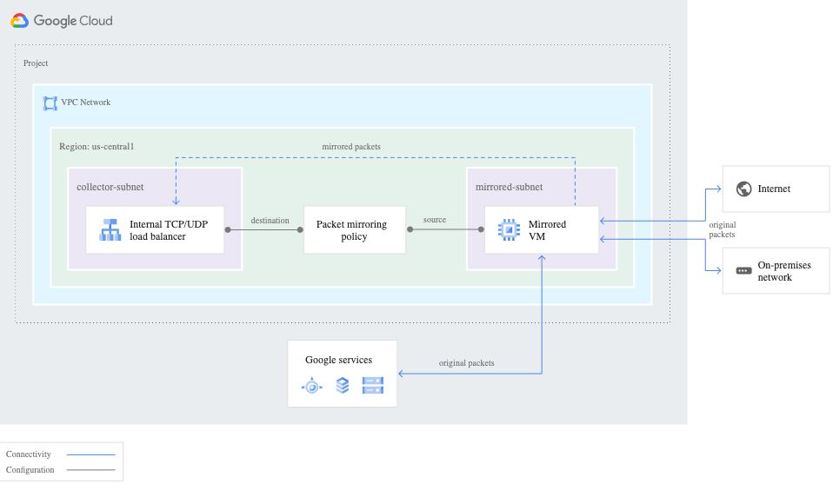
GCP Packet Mirroring
https://cloud.google.com/vpc/docs/packet-mirroring

Slide 26
GCP Packet Mirroring - Notes
An instance in GCP CANNOT have more than one network interface that resides within the same network/VPC.
This means that the Security Onion management interface (eth0) should reside in it’s own network/VPC.

Slide 27
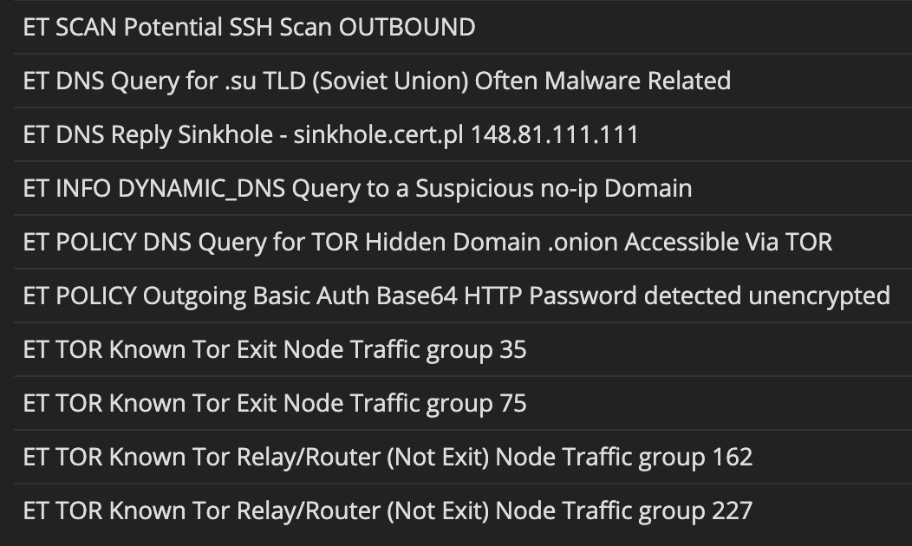
tmNIDS
Open-source
Written by Tiago Faria, 3CoreSec (0xtf)
Test alerting for cloud or on-premises NSM
quickly and easily
https://github.com/0xtf/testmynids.org

Slide 28
3CoreSec AutoMirror
Open-source
AWS Lambda function/serverless app
Quickly and easily facilitate cloud NSM
Monitors EC2 instances
If instances created with Mirror=True tag (and if instance is a supported type), their interfaces will be added to a VPC mirror session
Also works for instances that are tagged, then restarted
https://github.com/3CORESec/AWS-AutoMirror

Slide 29
Lab

Slide 30
Cloud Logs

Slide 31
Security Onion: Azure Data

Slide 32
Security Onion: Azure Configuration
Create a resource group
Create an Event Hubs namespace
Create an event hub
Stream logs to the event hub
Use the azure Filebeat module to ingest data into Security Onion
https://docs.microsoft.com/en-us/azure/event-hubs/event-hubs-create
https://docs.microsoft.com/en-us/azure/active-directory/reports-monitoring/tutorial-azure-monitor-stream-logs-to-event-hub
https://docs.securityonion.net/en/latest/filebeat.html#modules
https://www.elastic.co/guide/en/beats/filebeat/current/filebeat-module-azure.html

Slide 33
Security Onion: GCP Data

Slide 34
Security Onion: GCP Configuration
Configure Audit (IAM&Admin->Default audit config))
Configure VPC flow logs (VPC network -> Flow logs -> Configure)
Logs Viewer -> Create Sink -> Pub/Sub topic
Create subscription
Create service account with the Pub/Sub Editor role
Configure Filebeat module in Security Onion
https://docs.securityonion.net/en/latest/filebeat.html#modules
https://www.elastic.co/blog/monitoring-google-cloud-with-the-elastic-stack-and-google-operations

Slide 35
Security Onion: AWS

Slide 36
Security Onion: AWS Cloudtrail Configuration
Configure Cloudtrail to send to S3 bucket (also configure S3 bucket notify SQS)
Filebeat pulls from SQS/S3 and processes into Elastic Stack on Security Onion
Sift through data in Hunt and/or alert internally/centrally using
https://docs.securityonion.net/en/latest/filebeat.html#walktrough-aws-cloudtrail-logs

Slide 37
Lab

Slide 38
Additional Tools

Slide 39
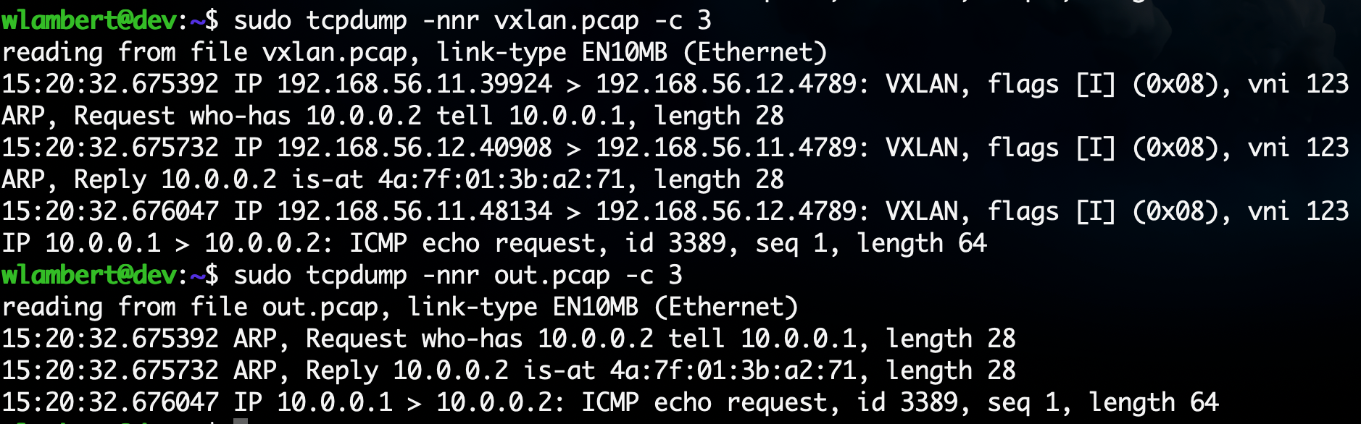
vxlan2pcap
Convert VXLAN-encapsulated PCAP to be readable by tools that do not support VXLAN encapsulation:
./vxlan2pcap vxlan.pcap out.pcap
https://github.com/Security-Onion-Solutions/securityonion-cloud/tree/dev/vxlan2pcap

Slide 40
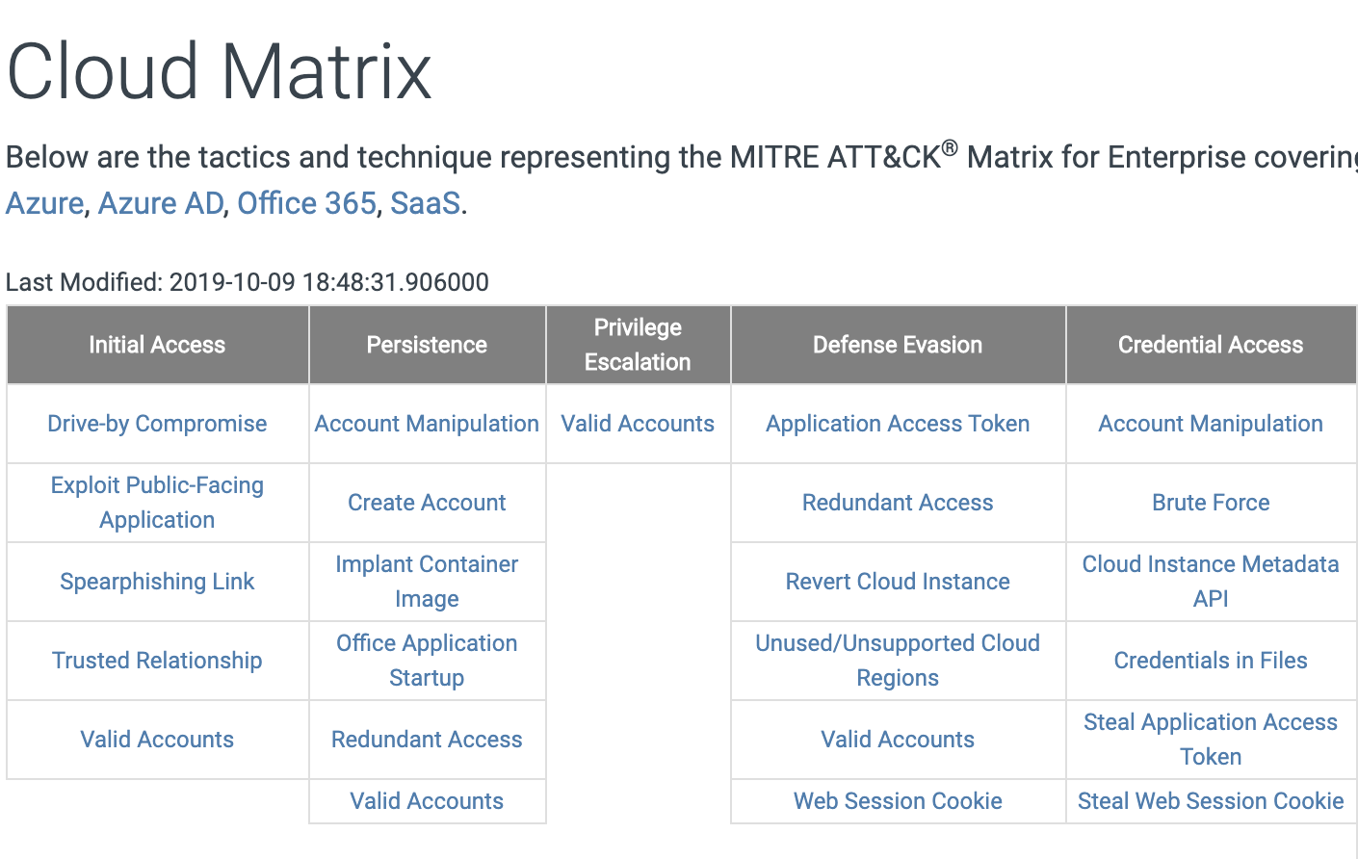
MITRE ATT&CK Cloud Matrix
Adversary tactics and techniques relative to cloud environments
Create detections for TIDs through the use of Sigma/Playbook.
Test detections using ART tests, RTA, or Prelude Operator
Map coverage with ATT&CK Navigator
https://attack.mitre.org/matrices/enterprise/cloud/
https://github.com/redcanaryco/atomic-red-team

Slide 41
Automated Deployment/Testing

Slide 42
Test AWS Traffic Mirroring and 3CS AutoMirror with Security Onion
Follow the instructions below to setup a full-fledged VPC that includes:
Security Onion
Ubuntu/Windows hosts
AutoMirror functionality to automatically mirror the traffic for each of the hosts
https://github.com/Security-Onion-Solutions/securityonion-cloud/tree/master/terraform/aws

Slide 43
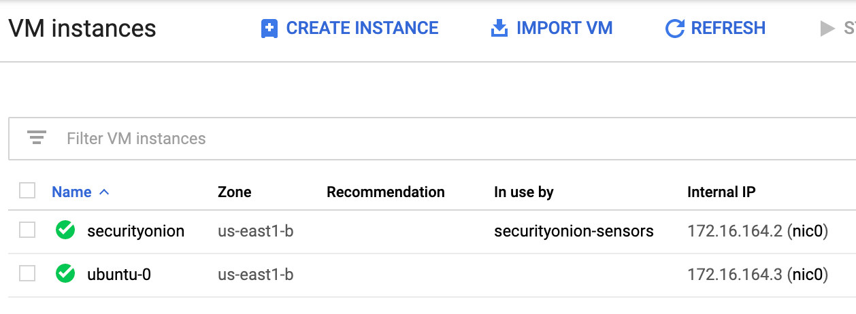
Test GCP Packet Mirroring with Security Onion
https://github.com/Security-Onion-Solutions/securityonion-cloud/tree/master/terraform/gcp

Slide 44
Contact/Additional Information
@therealwlambert
@securityonion
Download Security Onion
http://securityonion.net/download
Documentation:
https://securityonion.readthedocs.io
Professional Services and Support
https://securityonionsolutions.com
AMI:
https://docs.securityonion.net/en/2.3/cloud-ami.html#aws-cloud-ami
Cloud Resources
http://github.com/security-onion-solutions/securityonion-cloud

